Slide 1

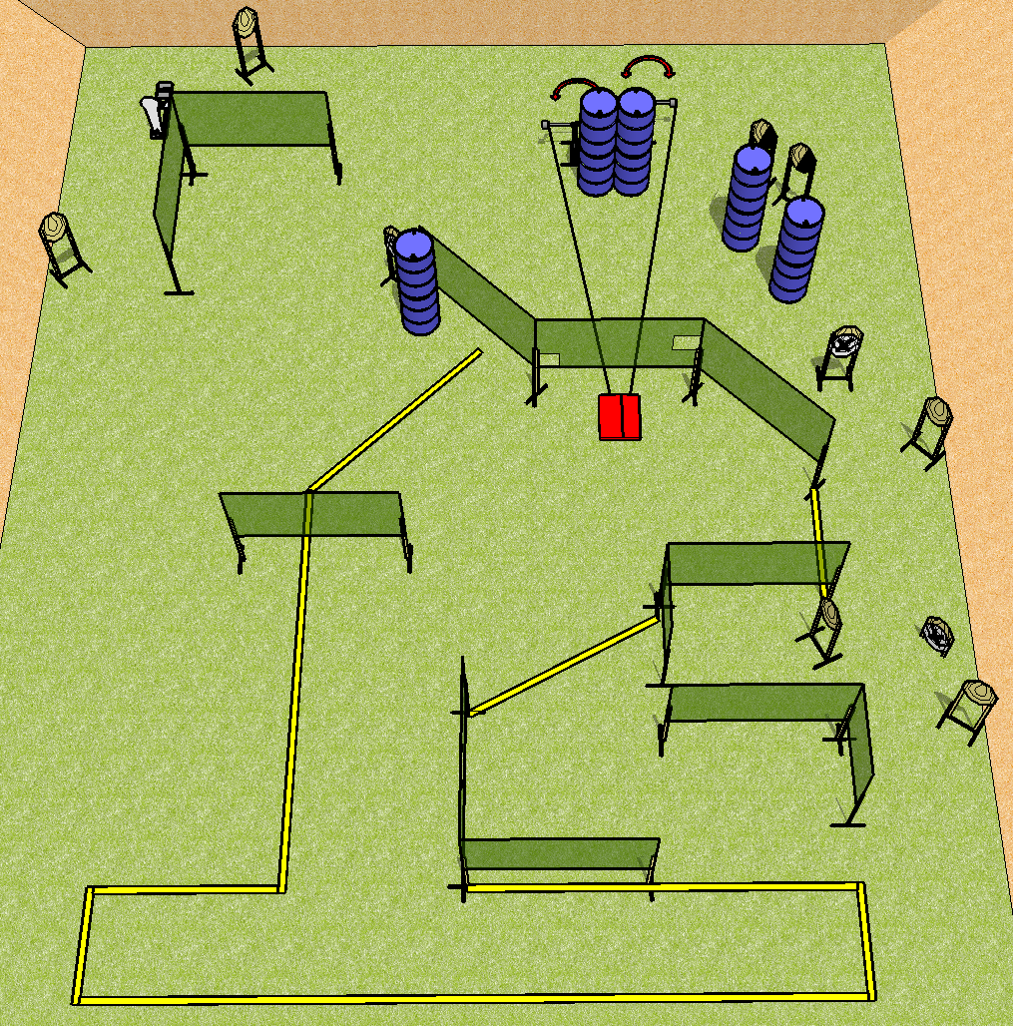
 | Dothan Practical Shooters – USPSA Match Unkind Course Designer : Drew Coleman Bay:
Round Count 25 rounds 12 IPSC 1 colt popper
Equipment List Stomp pad 2 swingers 13 targets (10 + 3 NS) 2 right diag

Slide 2
Unkind
Written Stage Briefing
Scoring: Comstock Rounds: 25
Targets: 12 IPSC, 1 steel
Handgun start position: feet on X’s, wrists below belt. Handgun is loaded and holstered.
PCC start position: feet on X’s, stock on belt. Loaded carbine is held with both hands, safety on.
Stage Procedure: on the audible start signal, engage targets as they become available from within the shooting area. The swingers are activated by the stomp pad and remain visible at rest. The stomp pad is part of the shooting area.

